Slide 1

WEL - COME

Slide 2
B.A. Part-III (2021-22)
English Comp.
A Presentation
By
Aayesha Jabeen Saudagar on
Communication Skills
Union Education Society's
Mahila Mahavidyalaya, Solapur.

Slide 3
Introduction:–
Literacy skills: Being literate means having the skills to be able to read, write and speak to understand and create meaning.
Life skills: The World Health Organization defines life-skills as, "abilities for adaptive and positive behaviour that enable individuals to deal effectively with the demands and challenges of everyday life." Thus, life skills are basic skills that help individuals in leading a meaningful life and better adjustment in the society.
Other skills: Communication,Customer service,Problem-solving,Time management,Leadership
Hard skills are usually teachable while soft skills are typically personality traits that are much harder to develop and therefore extremely valuable to employers. In most cases, your soft skills can enhance your hard skills. For example, if you’re a detail-oriented software developer skilled in a computer programming language, you’ll likely be able to catch errors and correct issues in the code you and your team create.
.
.

Slide 4
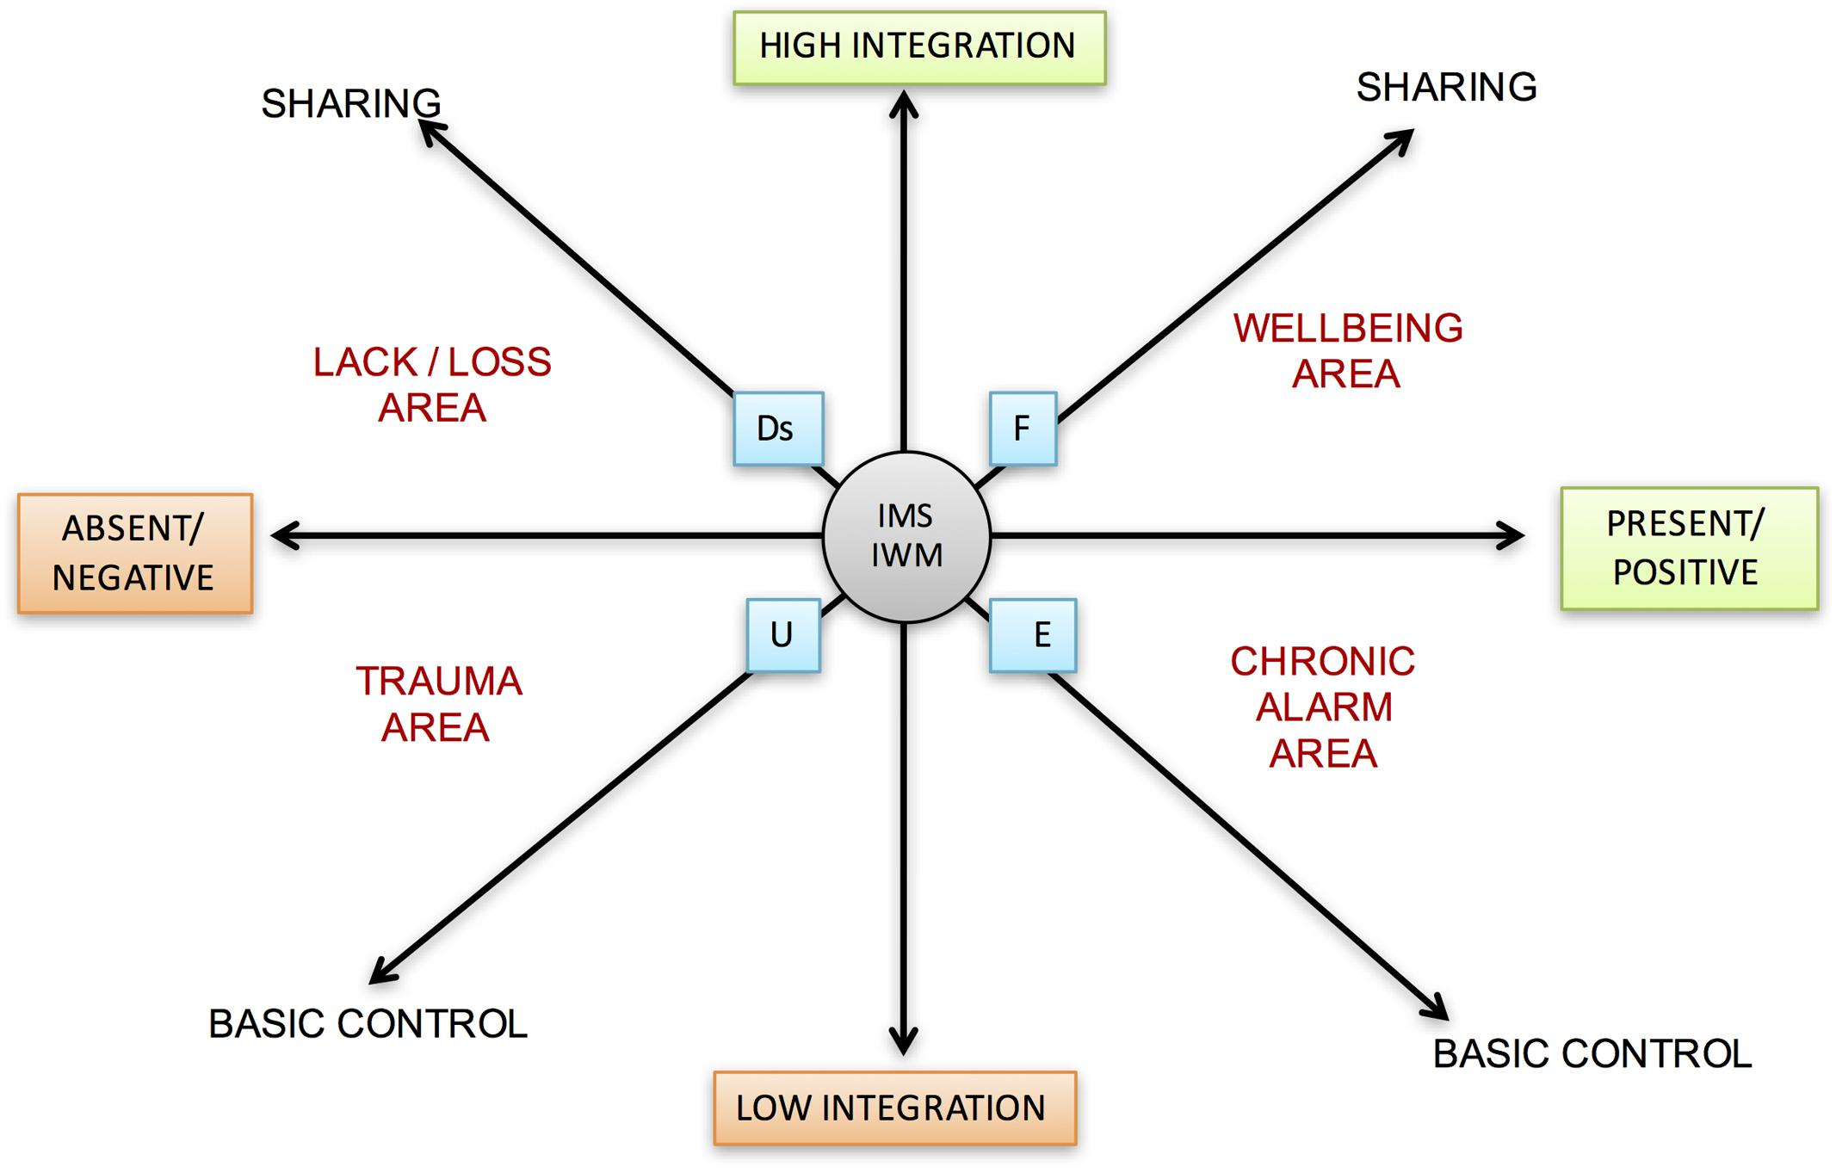
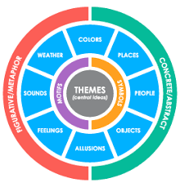
Theme:-
Literacy skills: Life skills:

Slide 5
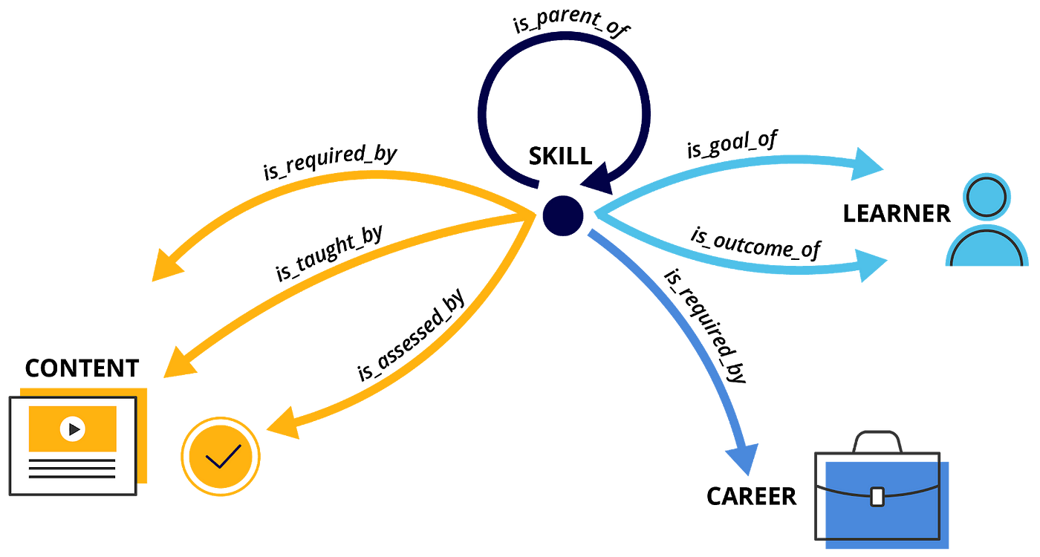
Other skills:

Slide 6
Conclusion:-
Literacy skills: Along with the resources, lessons and reading strategies aforementioned, we provide links to scholarly articles and websites that will help you reach a level of excellent in your craft. These articles and websites present effective strategies and pedagogical practices that enhance your students’ inquiry and critical thinking skills. Please enjoy navigating our wiki. Gain valuable literacy tools, access professional resources and take a trip back to the 90s while you’re at it!
Life skills: Providing life skills education helps to build the foundation for learning skills of individuals. In everyday life, the development of life skills helps students to: Find new ways of thinking and problem solving.
Other skills: Over the past twenty three weeks I have published a series of posts on Soft Skills: their development, the competencies they represents and the importance soft skills have in the workplace (or life in general, for that matter). I still like the following definition of Soft Skills because it is straight forward and concise: “’ Soft Skills’ is a catch-all term referring to various behaviors that help people work and socialize well with others. In short, they are the good manners and personality traits needed to get along with others and build positive relationships. Unlike hard skills,

